Slide 1

Recycling Game – working title
OCT 5, 2016
Team: we’re not trash
Aubrey Isaacman : Product Owner
Nathan Lie : Scrum Master
Hersh Gill
Michael Schmidt
Danielle Fisher

Slide 2
Project Release plan
Android game application focused on educating & gameifying recycling.
An Interactive app that can make recycling easy by showing user’s what is recyclable, and educate on proper disposal of waste.

Slide 3
SPRINTS
Sprint 1 : unpolished version of the game.
Sprint 2 : user profile, Avatar
Sprint 3 : polishing

Slide 4
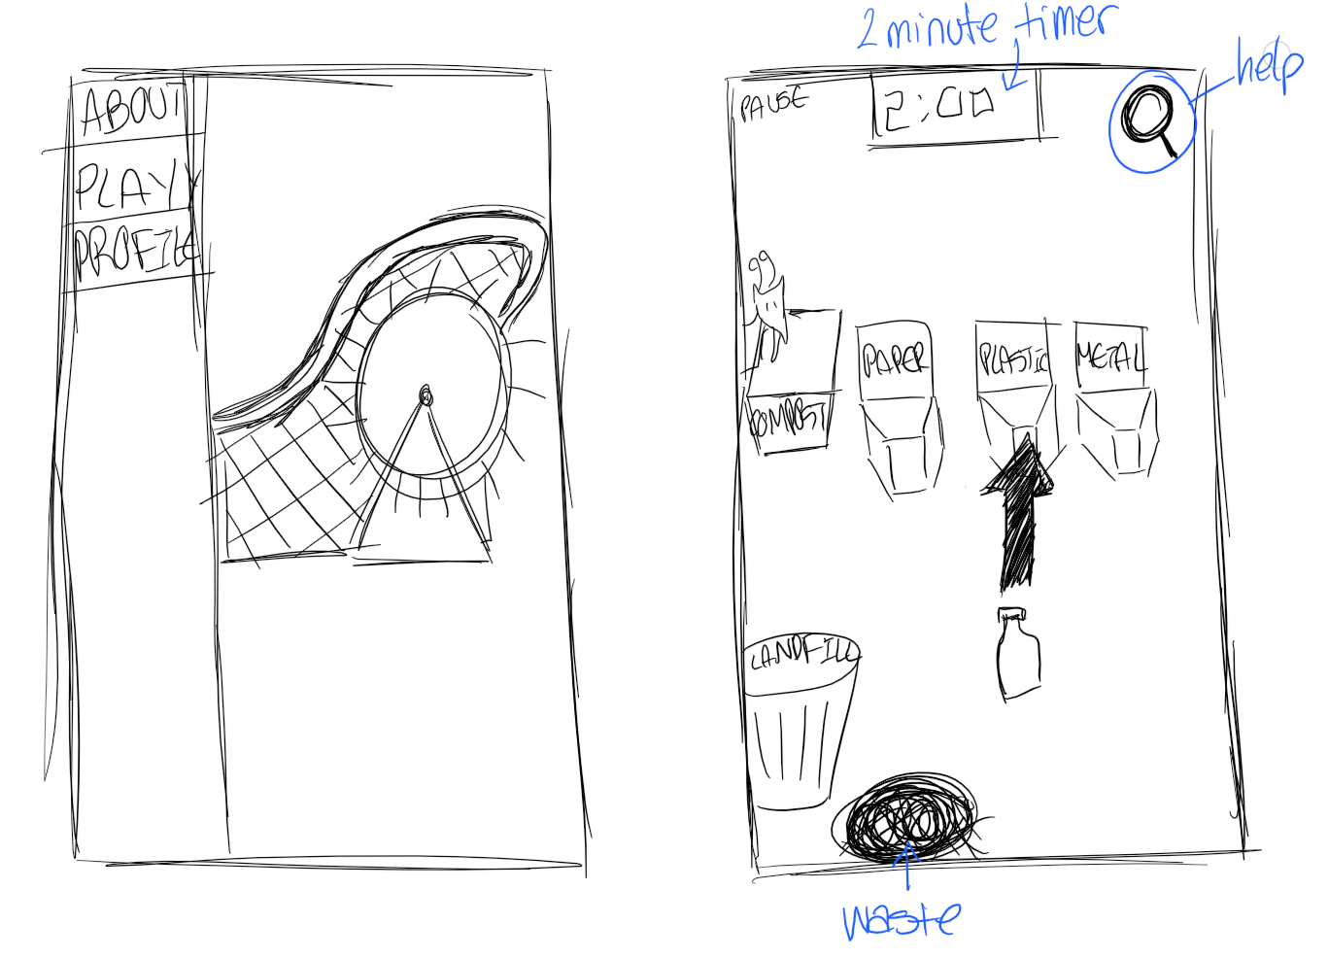

Slide 5
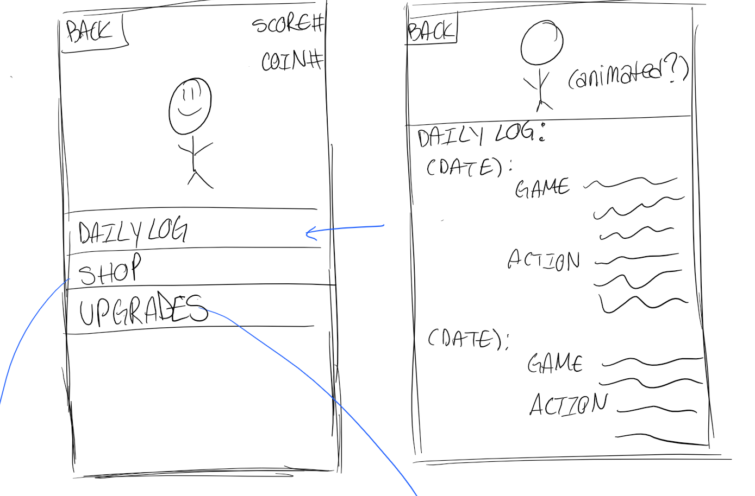

Slide 6
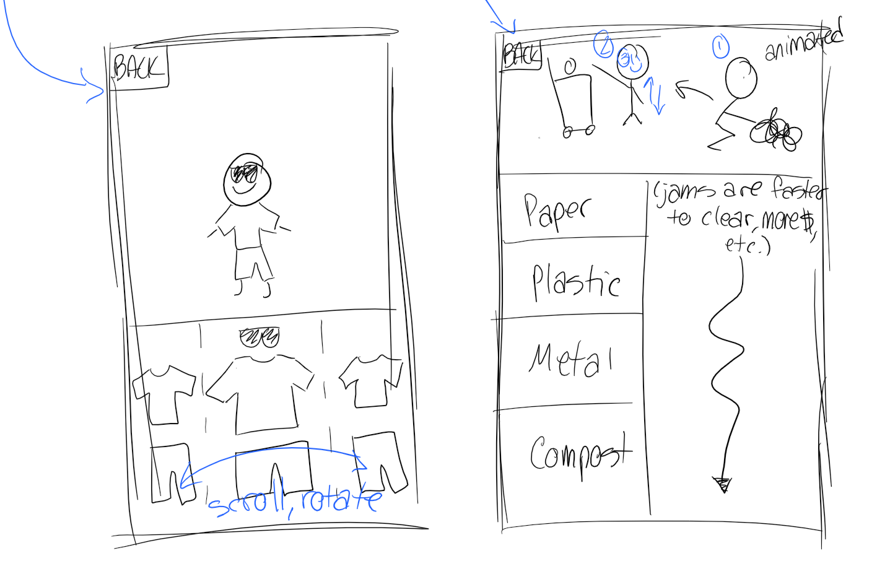

Slide 7
Challenges
Challenge/Risk 1 : Scanning barcode product
Challenge/Risk 2 : built-in database
Challenge/Risk 3 : unfamiliarly with Android

Slide 8
Game Technology
Technology 1 : Android App
Technology 2 : HTML5/CSS/JavaScript
Technology 3: Android Studio / Netbeans IDE

